Slide 1

Catch Me…If You Can

Slide 2
Bad People do Bad Things

Slide 3
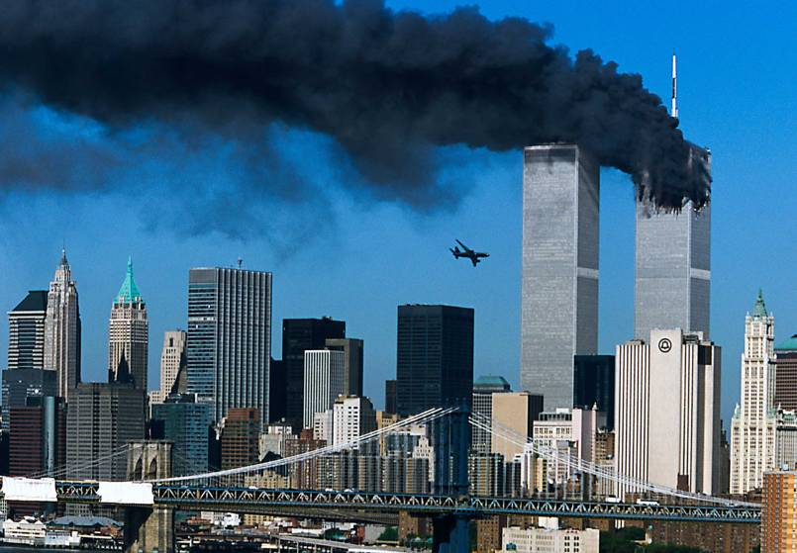

Slide 4
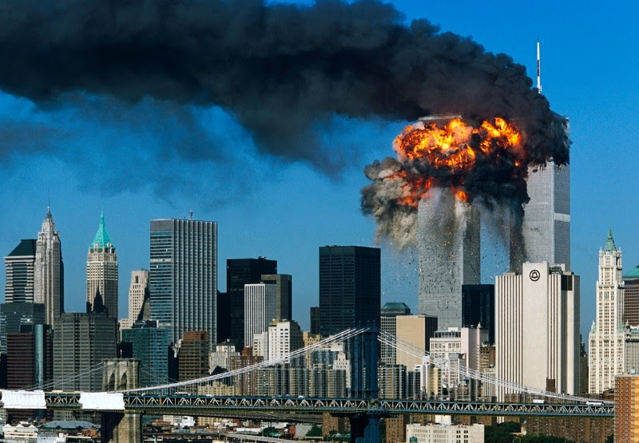

Slide 5
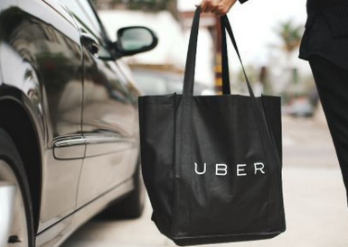


9/11 cost the Al Qaeda USD500,000
They trained terrorists to fly, travel & live in the USA
How did they get the $$$ from wherever to terrorists in the USA?

Slide 6
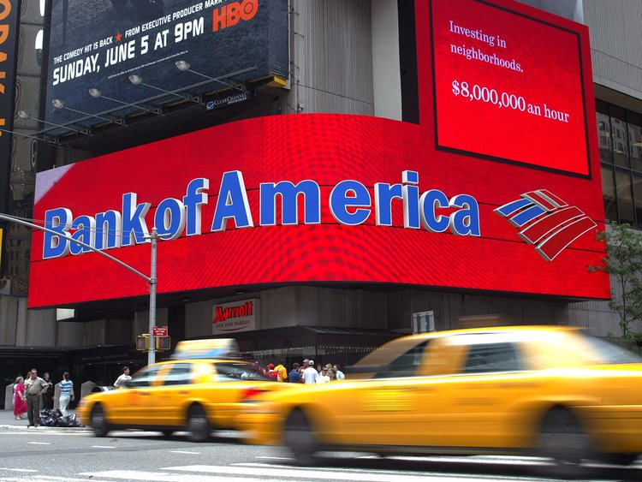

Slide 7
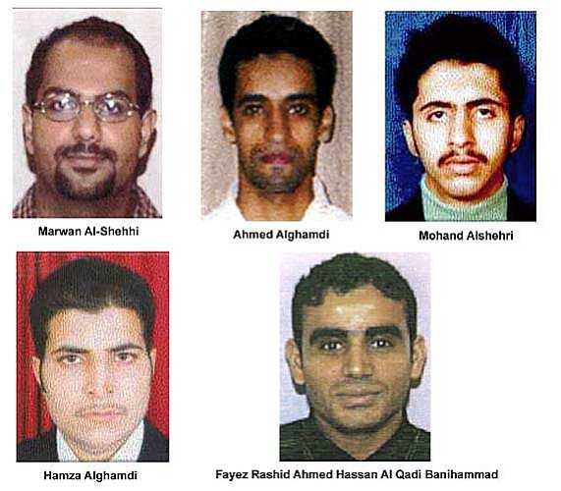

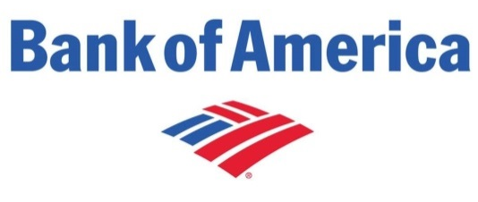
1
Accounts directly received and sent wire transfers of small amounts to and from foreign countries
The $500,000 laundered for 9/11 is small
Estimates suggest that money laundered globally in one year is 2 - 5% of global GDP. $2 trillion USD
2
Deposit made
Withdrawal occurred immediately
3
Withdraw cash in excess of the limit of the debit card
Src: Unodoc

Slide 8
Money Launderers are thumbing their noses

Slide 9
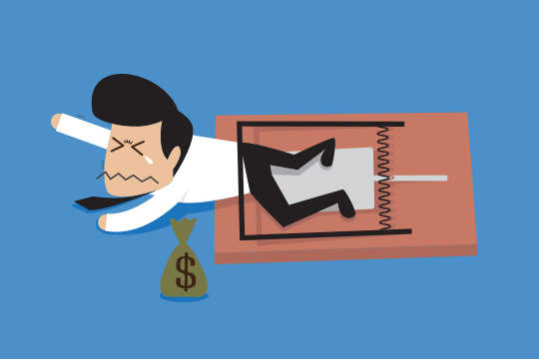
Challenge Accepted

Slide 10
Find Bank Fraud Faster for Compliance Officers

Slide 11
Find Bank Fraud Faster for Compliance Officers
It Should
Take in a list of transactions and pre-loaded customer database
Match transactions against known fraud scenarios
Tell the compliance officer which customers transaction are suspicious to money laundering
What’s Cool About it?
Enhance customer confidence and serves as deterrence to the Fraudsters due to proactive fraud detection mechanism
Reduce bank’s investigation cost through proactive early fraud detection and identification of traceable transaction patterns
Serves to identify financial criminals
Identifies transactions that circumvent regulatory policies (e.g. per day withdrawal limit)
Saves Bank reputation by earlier detection

Slide 12
?
How
Extract Knowledge
Build System
Build Rules
Lemme Show You

Slide 13
Extract Knowledge
Build System
Build Rules
Lemme Show You

Slide 14

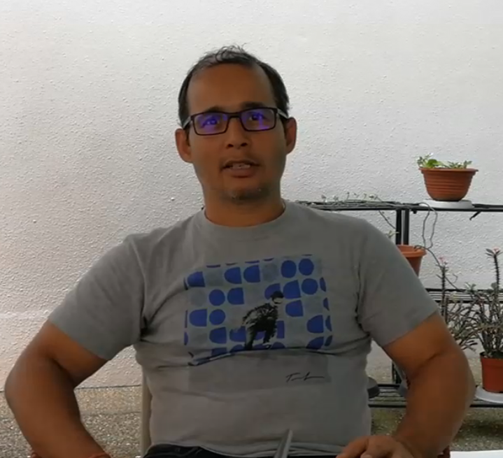
What is the process which you – or your team – identify suspicious cash transactions?
what are the most common, maybe the 10 most common static scenarios that you encounter in your line of work?
Our SME
Compliance Programmer
Worked in 4 Financial Institutions
13 Years experience
What are the common red flags which indicate fraud?
can you share more about the types of fraud that can happen in cash transactions, cash-related transactions.

Slide 15



Customers
Our SME
Compliance Programmer
Worked in 4 Financial Institutions
13 Years experience
Transactions
Fraud Attributes
& Scenarios

Slide 16
Customer Composition Tree
Operating Countries
Annual Turnover
Company Profile
Business Entity Type
Corporate Account
Risk Factor
Debit
Subset of Txn Mode
Customers
Transactions
Credit
Subset of Txn Mode
Name
Customer Bank Account
Age
Personal Particulars
Address
Birth Country
Transactions
Citizenship(s)
Personal Profile
Employment Status
Income Details
Monthly Income
Individual Account
Risk Factor
Txn Mode
Subset of Txn Mode
Fraud Attributes
& Scenarios
Cheque
Debit
Cash
Transactions
Credit/ Debit Card
Credit
Subset of Txn Mode
Internet Transfers

Slide 17
Customer Composition Tree
Operating Countries
Annual Turnover
Company Profile
Business Entity Type
Corporate Account
Risk Factor
Debit
Subset of Txn Mode
Customers
Transactions
Credit
Subset of Txn Mode
Name
Customer Bank Account
Age
Personal Particulars
Address
Birth Country
Transactions
Citizenship(s)
Personal Profile
Employment Status
Income Details
Monthly Income
Individual Account
Risk Factor
Txn Mode
Subset of Txn Mode
Fraud Attributes
& Scenarios
Cheque
Debit
Cash
Transactions
Credit/ Debit Card
Credit
Subset of Txn Mode
Internet Transfers

Slide 18
Bank Transaction Composition Tree
Customers
Bank Transaction
Debit Transaction
Credit Transaction
Withdraw
Payment method
Transfer
Deposit
Payment method
Transfer
Transactions
ATM
Bank Counter
Cheque
Debit Card
Credit Card
Internet Banking
Wire Transfer
Cash Deposit at ATM
Bank Counter
Cheque
3rd party Payment
Internet Banking
Wire Transfer
Fraud Attributes
& Scenarios

Slide 19
Bank Transaction Composition Tree
Customers
Bank Transaction
Debit Transaction
Credit Transaction
Withdraw
Payment method
Transfer
Deposit
Payment method
Transfer
Transactions
ATM
Bank Counter
Cheque
Debit Card
Credit Card
Internet Banking
Wire Transfer
Cash Deposit at ATM
Bank Counter
Cheque
3rd party Payment
Internet Banking
Wire Transfer
Fraud Attributes
& Scenarios

Slide 20
Money Laundering Using Cash Transactions
a. Unusually large cash deposits made by an individual or company whose ostensible
business activities would normally be generated by cheques and other instruments
b. Substantial increases in cash deposits of any individual or business without apparent
cause, especially if such deposits are subsequently transferred within a short period out
of the account and/or to a destination not normally associated with the customer
c. Customers who deposit cash by means of numerous credit slips so that the total of each
deposit is unremarkable, but the total of all the credits is significant
d. Company accounts whose transactions, both deposits and withdrawals, are denominated
by cash rather than in the forms of debit and credit normally associated with commercial
operations (e.g. cheques, Letters of Credit and Bills of Exchange)
e. Customers who constantly pay-in or deposit cash to cover requests for bankers drafts,
money transfers or other negotiable and readily marketable money instruments
f. Customers who seek to exchange large quantities of low denomination notes for those of
higher denomination
g. Frequent exchange of cash into other currencies
h. Branches that have a great deal of cash transactions than usual (Head Office statistics
detect aberrations in cash transactions)
i. Customers whose deposits contain counterfeit notes or forged instruments
j. Customers transferring large sums of money to or from overseas locations with
instructions for payment in cash
k. Large cash deposits using night safe facilities, thereby avoiding direct contact with bank
staff
2. Money Laundering Using Bank Accounts
a. Customers who wish to maintain a number of trustee or clients’ accounts, which do not
appear consistent with the type of business, including transactions which involve
nominee names
b. Customers who have numerous accounts and pay in amounts of cash to each of them in
circumstances in which the total of credits would be a large amount
c. An account that shows virtually no normal personal banking or business related activities,
but is used to receive or disburse large sums which have no obvious purpose or
relationship to the account holder and/or his business (e.g. a substantial increase in
turnover on an account)
d. Reluctance to provide normal information when opening an account, providing minimal or
fictitious information or, when applying to open an account, providing information that is
difficult or expensive for the banking institution to verify
e. Matching of payments out with credits paid in by cash on the same or previous day
f. Paying in large third party cheques endorsed in favour of the customer
g. Large cash withdrawals from a previously dormant/inactive account, or from an account
which has just received an unexpected large credit from abroad
h. Customers who together, and simultaneously, use separate tellers to conduct large cash
6 Fraud Scenarios. Customer Focused. Cash Transactions Only
Large amount cash transaction, when user’s default mode is ATM transaction
Multiple deposits made to an account using a number of different ways (e.g. cash deposit, money transfer). These add up to a large amount over a short period of time
Multiple credits to the account on the same day
Small denominations debited to an account. Resulting in a large total amount
Large amounts of foreign currency money transferred to an account
Multiple credits and debits to an account over a short period of time
Customers
Transactions
Fraud Attributes
& Scenarios

Slide 21
Fraud Detection Attribute Tree
Low
Account Risk
Medium
High
Cash Txn Count
Transaction Mode
(Default Mode with Highest Count)
Cheque Txn Count
Internet Transfer Txn Count
Customers
GIRO Txn Count
Transaction Period by Day
YYYYMMDD
Cash Denominations
Low (S$2 – S$100)
Fraud Detection Attributes
High (S$1,000 – S$10,000)
Currency Type
(Default Currency: SGD)
SGD
Transactions
Foreign Currencies
Transaction Type
Credit
Debit
Transacted Amount
Total Transacted Amount over a Period (5days)
Total Transacted Amount
Fraud Attributes
& Scenarios
Total Transacted Count over a Period (5days)
Transacted Count
Total Transacted Count

Slide 22
Fraud Detection Attribute Tree
Low
Account Risk
Medium
High
Cash Txn Count
Transaction Mode
(Default Mode with Highest Count)
Cheque Txn Count
Internet Transfer Txn Count
Customers
GIRO Txn Count
Transaction Period by Day
YYYYMMDD
Cash Denominations
Low (S$2 – S$100)
Fraud Detection Attributes
High (S$1,000 – S$10,000)
Currency Type
(Default Currency: SGD)
SGD
Transactions
Foreign Currencies
Transaction Type
Credit
Debit
Transacted Amount
Total Transacted Amount over a Period (5days)
Total Transacted Amount
Fraud Attributes
& Scenarios
Total Transacted Count over a Period (5days)
Transacted Count
Total Transacted Count

Slide 23
Cash Transaction Fraud Scenario Decision Tree
Account
* Each account type will have a similar decision branches to the fraud scenarios, however, the thresholds used will be different
Individual*
Organization*
Multiple Txn
Single Txn
...
Single Day
Over a Period
Normal/High Denomination Amount
Low Denomination Amount
Customers
Normal Txn Count
High Txn Count
Normal Txn Count
Very High Txn Count
High Txn Count
Normal Txn Amount
High Txn Amount
Normal Txn Amount
High Txn Amount
Fraud Scenario 8
Fraud Scenario 1
Fraud Scenario 9
Credit Type
Others
Fraud Scenario 3
Debit Type
Others
Credit Type
Debit Type
Credit Type
Both
Transactions
Local Currency
Foreign Currency
Local Currency
Foreign Currency
Normal /High Denomination Amount
Low Denomination Amount
Low Denomination Amount
Normal / High Denomination Amount
Low Denomination Amount
Normal/High Denomination Amount
Normal Txn Amount
High Txn Amount
Normal Txn Amount
High Txn Amount
Normal Txn Amount
High Txn Amount
Normal Txn Amount
High Txn Amount
Normal Txn Amount
High Txn Amount
Fraud Scenario 5
Fraud Scenario 2
Fraud Scenario 7
Fraud Scenario 6
Fraud Attributes
& Scenarios
Fraud Scenario 4

Slide 24
Cash Transaction Fraud Scenario Decision Tree
Account
* Each account type will have a similar decision branches to the fraud scenarios, however, the thresholds used will be different
Individual*
Organization*
Multiple Txn
Single Txn
...
Single Day
Over a Period
Normal/High Denomination Amount
Low Denomination Amount
Customers
Normal Txn Count
High Txn Count
Normal Txn Count
Very High Txn Count
High Txn Count
Normal Txn Amount
High Txn Amount
Normal Txn Amount
High Txn Amount
Fraud Scenario 8
Fraud Scenario 1
Fraud Scenario 9
Credit Type
Others
Fraud Scenario 3
Debit Type
Others
Credit Type
Debit Type
Credit Type
Both
Transactions
Local Currency
Foreign Currency
Local Currency
Foreign Currency
Normal /High Denomination Amount
Low Denomination Amount
Low Denomination Amount
Normal / High Denomination Amount
Low Denomination Amount
Normal/High Denomination Amount
Normal Txn Amount
High Txn Amount
Normal Txn Amount
High Txn Amount
Normal Txn Amount
High Txn Amount
Normal Txn Amount
High Txn Amount
Normal Txn Amount
High Txn Amount
Fraud Scenario 5
Fraud Scenario 2
Fraud Scenario 7
Fraud Scenario 6
Fraud Attributes
& Scenarios
Fraud Scenario 4

Slide 25
Extract Knowledge
Build System
Build Rules
Lemme Show You

Slide 26
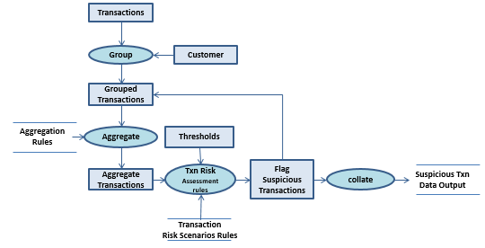
Inference Engine

Slide 27
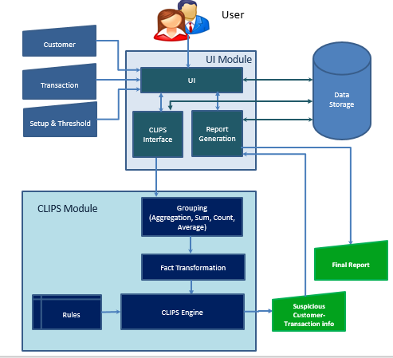
System Architecture

Slide 28
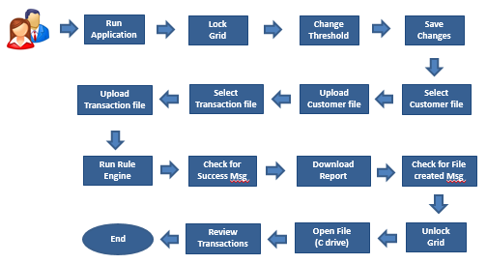
User flow

Slide 29
Extract Knowledge
Build System
Build Rules
Lemme Show You

Slide 30
Customer Facts
Customer Transactions Detail
Customer Details
Details of Customer Transactions
(deftemplate customer_trxn
(slot customer_id)
(slot cust_type) (slot trxn_id)
(slot total_trxn_amt)
(slot benef_id) (slot ftc_ind)
(slot denom) (slot cust_risk_ind) (slot dr_cr_ind)
)
(deffacts cust_trxn_dtl
(customer_trxn (customer_id 1) (cust_type ind) (dr_cr_ind dr) (trxn_id 10004) (total_trxn_amt 3000) (benef_id 20) (ftc_ind 0) (denom 0) (cust_risk_ind 6))
(customer_trxn (customer_id 1) (cust_type ind) (dr_cr_ind dr) (trxn_id 10000) (total_trxn_amt 3000) (benef_id 19) (ftc_ind 0) (denom 0) (cust_risk_ind 2))
(customer_trxn (customer_id 1) (cust_type ind) (dr_cr_ind cr) (trxn_id 10001) (total_trxn_amt 5000) (benef_id 23) (ftc_ind 1) (denom 1) (cust_risk_ind 10))
(customer_trxn (customer_id 1) (cust_type ind) (dr_cr_ind dr) (trxn_id 10002) (total_trxn_amt 15000) (benef_id 23) (ftc_ind 0) (denom 1) (cust_risk_ind 2)
)

Slide 31
Aggregation Rules
Transaction
Risk Scenarios
Prepares customer & Transaction facts for risk evaluation
Evaluates Facts for Fraud Scenario selection
(defrule total_amt_cnt =>
(bind ?count 0)
(bind ?sum 0)
(do-for-all-facts ((?f customer_trxn)) TRUE
(bind ?count (+ ?count 1))
(bind ?sum (+ ?sum ?f:total_trxn_amt))
)
(assert (trxn_tot_amt ?sum))
(assert (trxn_tot_cnt ?count))
;(printout t ?sum " sum " ?count " count " crlf)
)
(defrule scn1_trxn_cnt_check_ind
(scn1_ind_trxn_amt ?trxn_amt_th) (scn1_ind_trxn_cnt ?trxn_cnt_th)
(trxn_tot_amt ?trxn_tot_amt) (trxn_tot_cnt ?trxn_tot_cnt)
(customer_trxn (customer_id ?id) (cust_type ?cust_type) (trxn_id ?trxn_id))
(test (> ?trxn_tot_cnt ?trxn_cnt_th)) (test (eq ?cust_type ind))
(test (> ?trxn_tot_amt ?trxn_amt_th)) =>
(open "data_output.dat" data1 "a")
(printout data1 (str-cat ?id","?trxn_id",SCENARIO1") crlf)
(close data1)
(printout t ?id " is individual category alerted in scnearion high count and high value transaction " crlf)
)

Slide 32
Extract Knowledge
Build System
Build Rules
Lemme Show You

Slide 33
Use Case 1: Customer with Normal Transactions which does not classify under any of the 6 fraud detection scenarios
Use Case 2: Customer with Fraudulent Transactions who is identified under one of the 6 fraud detection scenarios
Use Case 3: How change of threshold value impacts classification of transaction as fraudulent to non-fraudulent

Slide 34

Find Bank Fraud Faster for Compliance Officers

